Slide 1
Scheduling Achievement Tests
Requires Pearson VUE account
No appointment necessary

Slide 2
Dell Learning
Navigate to www.PearsonVUE.com/Dell
Login or Create Account
View online exams
Select exam
Select language
Agree to Dell Technologies policies
Confirm information is correct OR
Add another Exam
When ready > Next
Submit Order
Begin Exam
Scheduling an Achievement test @ Pearson VUE

Slide 3
Logging In
Navigate to www.PearsonVUE.com/Dell
Sign In OR Create account

Slide 4
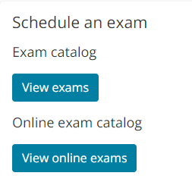
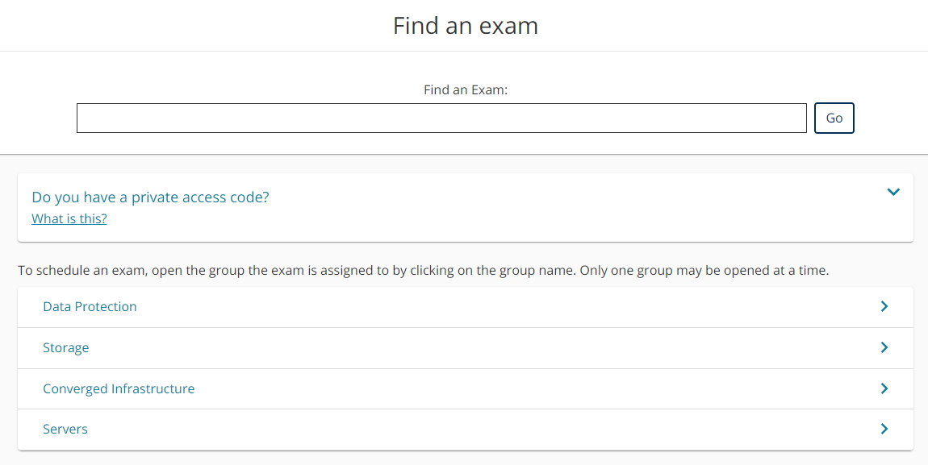
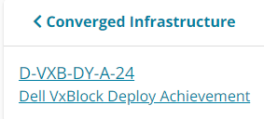
Select Exam
View online exams
Select exam
Search by exam name or number
OR
Expand group and select from list

Slide 5
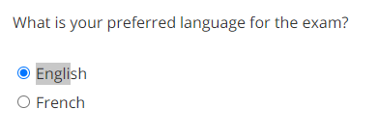
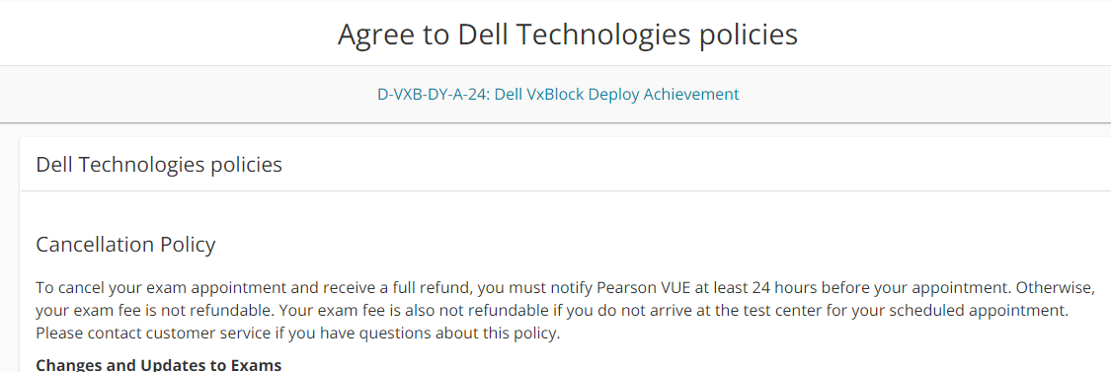
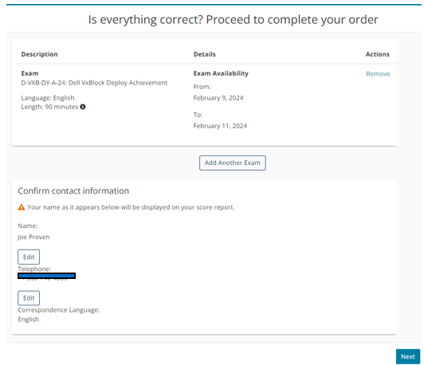
Select exam con’t
Select language (options will vary by exam)
Agree to Dell Technologies policies
Confirm information is correct OR
Add another Exam
When ready > Next
Tests are available for 48 hours
Exam Availability can be found on the order form in the top middle

Slide 6
Submit Order
Submit order
Begin exam
Tests are available for 48 hours
Exam Availability can be found on the order form in the top middle

